Slide 1
Scheduling Algorithms
Instructor: William Zheng
Email: william.zheng@digipen.edu
PHONE EXT: 1745
Notes:
1

Slide 2
Lecture Outline
Scheduling Intro
Preemptive and Non-preemptive algos
Types of Processes
Scheduling rubrics
Non-preemptive Scheduling Algos
FCFS (First Come First Serve)
SJF
Preemptive Scheduling Algos
Round-Robin
Multilevel Queues
Multilevel Queues with feedback
Notes:
2

Slide 3
Preemptive and Non-preemptive Scheduling
Non-preemptive schedules only when
A process terminates
A process goes into waiting state
Preemptive schedules also when
A hardware interrupt arrives
Process goes from waiting to ready state.
Process goes from running to ready state.
A software-generated interrupt (system call)
I/O request occurs requesting to access a file on hard disk
Notes:
3

Slide 4
Types of processes
What processes/threads do?
Compute
I/O
Types of processes/threads
I/O bound
Compute/CPU bound
CPU
I/O
…
CPU burst
I/O burst
Notes:
4

Slide 5
Scheduling Effectiveness
Waiting time
Turnaround time
Response time
Enter Ready
Queue
Process
Start to run
Enter Ready
Queue
Process
Terminates
I/O
Request
I/O
Processing
Turnaround time – amount of time to execute a particular process
Waiting time – amount of time a process has been waiting in the ready queue
Response time – amount of time it takes from when a request was submitted until the first response is produced, not output (for time-sharing environment)
Notes:
5

Slide 6
First Come First Serve
Schedule according to arrival order
Implemented using a queue data struct
What’s a queue data struct?
Basically a linked-list
Always read from front of linked list
Always add to end of the linked list
Notes:
6

Slide 7
FCFS waiting time example
P₁ 19 ms
P₂ 7 ms
P₃ 5 ms
Schedule
Wait time(P₁) = 0 ms
Wait time(P₂) = 19 ms
Wait time(P₃) = 26 ms
Average wait time =
(0 ms + 19 ms + 26 ms)/3 = 15 ms
Notes:
7

Slide 8
FCFS scheduling with I/O
P₁ (10ms CPU, 4ms I/O, 3ms CPU)
P₂ (3ms CPU, 4ms I/O, 3ms CPU, 4ms I/O, 2ms CPU)
P₃ (5ms CPU, 5ms I/O, 8ms CPU)
Schedule:
P₁
(10ms)
P₂
(3ms)
P₃
(5ms)
P₁
(3ms)
P₂
(3ms)
P₃
(8ms)
P₂
(2ms)
CPU
P₁
(4ms)
I/O
P₂
(4ms)
P₂
(4ms)
P₃
(5ms)
Notes:
8

Slide 9
Priority Scheduling
A priority queue is a type queue with two operations
Put – place an item on the queue
Get - get the item with highest value item from the queue
Same as FCFS scheduling algorithm, except that the queue is replaced by a priority queue
What priority?
Based on feature of the jobs OR
A user-assigned priority value OR
Dynamic run-time priorities (pre-emptive versions)
Notes:
9

Slide 10
Shortest Job First
Also known as Shortest Remaining Time First.
Shortest-next-CPU-burst algo
Associates with each process the length of the process’s next CPU burst, rather than total length
Assigned to process with the smallest next CPU burst when CPU available
FCFS scheduling used to break the tie if the next CPU bursts of 2 processes are the same
Non-preemptive priority scheduling
Always schedule the job with shortest job or shortest remaining time.
Minimizes average waiting time.
Notes:
10

Slide 11
SJF waiting time example
P₁ 19 ms
P₂ 7 ms
P₃ 5 ms
Schedule
Wait time(P₁) = 12 ms
Wait time(P₂) = 5 ms
Wait time(P₃) = 0 ms
Average wait time =
( 12 ms + 5 ms + 0 ms)/3 = 17/3 ms
Notes:
11

Slide 12
SJF scheduling with I/O
P₁ (10ms CPU, 4ms I/O, 3ms CPU)
P₂ (3ms CPU, 4ms I/O, 3ms CPU, 4ms I/O, 2ms CPU)
P₃ (5ms CPU, 5ms I/O, 8ms CPU)
Schedule (according to next CPU burst):
Process in Ready Q before scheduling | P₁ 10ms P₂ 3ms P₃ 5ms | P₁ 10ms P₃ 5ms | P₁ 10ms P₂ 3ms | P₁ 10ms | P₂ 2ms P₃ 8ms | P₃ 8ms | P₁ 3ms
Scheduled Process | P₂ 3ms | P₃ 5ms | P₂ 3ms | P₁ 10ms | P₂ 2ms | P₃ 8ms | P₁ 3ms
Process in Waiting State after scheduling |  | P₂ 4ms | P₃ 3ms(of 5ms) | P₂ 4ms P₃ 2ms | P₁ 2ms | P₁ 2ms
Notes:
12

Slide 13
Priority scheduling problem
Starvation: a low priority job may sit on the queue indefinitely
Happens if there is always an incoming job request with a higher priority than the lowest priority job on the queue
Aging as a solution:
if a job has waited on the queue for a sufficiently long time, its priority is increased by a set amount
Notes:
13

Slide 14
Pre-emptive scheduling
Each job is allowed a time slice, or time quantum, in which to execute
Once a time quantum has passed, or if the job has finished within that time, a different job gets a time slice
A scheduling algorithm is used to determine the order in which jobs get a time slice.
Round robin (RR) scheduling
Multilevel queue scheduling
Multilevel feedback queue scheduling
Notes:
14

Slide 15
Round robin scheduling
Uses a FIFO queue to process jobs in a first-come first-serve order
Get a job from the front of the queue
Let it execute for a maximum of one time quantum
If it does not complete within that time
Pause the job, and put the job at the back of the queue
Repeat
Notes:
15

Slide 16
RR waiting time example (5ms slices)
Waiting time: Sum of the periods spent waiting in the ready queue
P₁ 7 ms
P₂ 19 ms
P₃ 5 ms
Schedule
Wait time(P₁) = 10ms
Wait time(P₂) = 12ms
Wait time(P₃) = 10ms
Average wait time =
(10 ms + 12 ms + 10 ms)/3 = 32/3 ms
1st part of waiting time for P₂ is 5ms
2nd part of waiting time for P₂ is
t₄-t₂=7ms, total=5+7=12ms,
i.e. total time spent in the ready
queue for the remaining job.
t₁
t₂
t₃
t₄
1st part of waiting time for P₁ is 0ms
2nd part of waiting time for P₁ is
t₃-t₁=5(P₂ )+5(P₃) =10ms
Notes:
16

Slide 17
RR waiting time example (10ms slices)
P₁ 7 ms
P₂ 19 ms
P₃ 5 ms
Schedule
Wait time(P₁) = 0ms
Wait time(P₂) = 12ms
Wait time(P₃) = 17ms
Average wait time =
(0 ms + 12 ms + 17 ms)/3 = 29/3 ms
1st part of waiting time for P₂ is 7ms
2nd part of waiting time for P₂ is
t₂-t₁=5(P₃ )=5ms
t₁
t₂
Notes:
17

Slide 18
RR scheduling with I/O (5 ms slices)
P₁ (10ms CPU, 4ms I/O, 3ms CPU)
P₂ (3ms CPU, 4ms I/O, 3ms CPU, 4ms I/O, 2ms CPU)
P₃ (5ms CPU, 5ms I/O, 8ms CPU)
Schedule:
P₁
(5ms)
P₂
(3ms)
P₃
(5ms)
P₁
(5ms)
P₂
(3ms)
P₃
(5ms)
P₁
(3ms)
P₂
(2ms)
P₃
(3ms)
CPU
P₁
(4ms)
I/O
P₂
(4ms)
P₂
(4ms)
P₃
(5ms)
Notes:
18

Slide 19
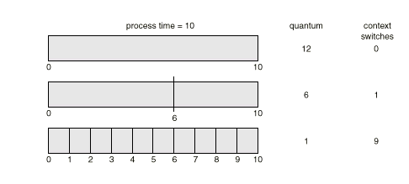
RR considerations
The average waiting time decreases (in general) with decreasing time quantum size
Context switching causes more processing time
A balance must be made between time quantum size and context switching time
Want the time quantum to be “large” with respect to the context switching time
Notes:
19

Slide 20
Multilevel queue scheduling
Ready queue is partitioned into separate queues
Jobs are put on different queues according to prioritization criteria
System jobs might have top priority
User jobs might have less priority
Background jobs might have least priority
Each queue has its own scheduling algorithm
Scheduling must be done between the queues. E.g.,
Fixed priority scheduling; (i.e., serve all from foreground then from background).
Problem: starvation.
Time slice – each queue gets a certain amount of CPU time which it can schedule amongst its processes; i.e., 80% to foreground in RR, 20% to background in FCFS
Problem: how to split?
Notes:
20

Slide 21
Multilevel feedback queue scheduling
Uses multiple queues, as in multilevel scheduling
However, a job may be moved between each of the different level queues, depending on CPU usage
If a job has long CPU burst cycles, it is put on a lower priority queue
Notes:
21

Slide 22
Multilevel feedback queue scheduling
Process can move between the various queues; aging can be implemented this way
Multilevel-feedback-queue scheduler defined by the following parameters:
number of queues
scheduling algorithms for each queue
method used to determine when to upgrade a process
method used to determine when to demote a process
method used to determine which queue a process will enter when that process needs service
Notes:
22

Slide 23
Example of Multilevel Feedback Queue
Three queues:
Q₀ – time quantum 8 milliseconds
Q₁ – time quantum 16 milliseconds
Q₂ – FCFS
Scheduling
A new job enters queue Q₀ which is served FCFS. When it gains CPU, job receives 8 milliseconds. If it does not finish in 8 milliseconds, job is moved to queue Q₁.
At Q₁ job is again served FCFS and receives 16 additional milliseconds. If it still does not complete, it is preempted and moved to queue Q₂.

Slide 24
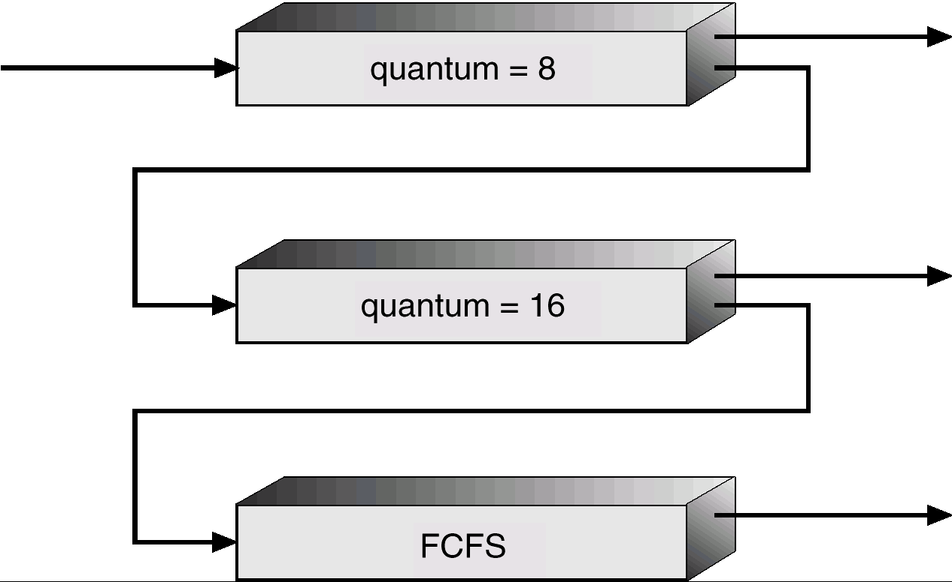
Multilevel Feedback Queues

Slide 25
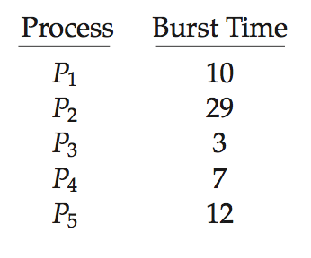
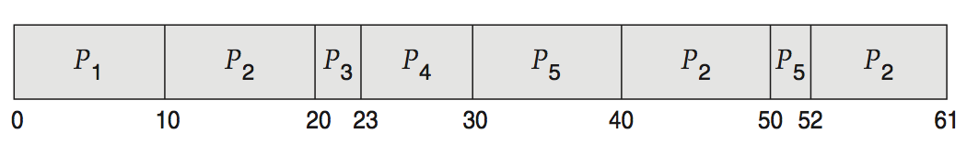
Evaluation (1)
Consider 5 processes arriving at time 0:
t₀
t₁
t₂
t₃
t₄
t₅
t₆
t₇
Preemptive Round Robin Scheduling (time quantum=10ms):
Waiting time for P₁ = 0 ms
Waiting time for P₂ =(t₁-t₀)+(t₅-t₂) +(t₇-t₆) =10+20+2 = 32 ms
Waiting time for P₃ = t₂-t₀ = 20 ms
Waiting time for P₄ = t₃-t₀ = 23 ms
Waiting time for P₅ = (t₄-t₀)+(t₆-t₅) = 40 ms
Average waiting time = (0+32+20+23+40)/5 = 23ms

Slide 26
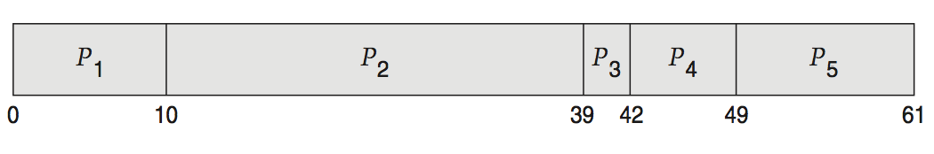
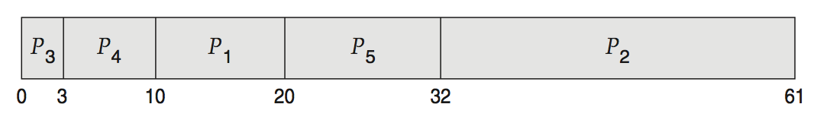
Evaluation (2)
FCFS is 28ms:
Non-preemptive SFJ is 13ms:
RR is 23ms:

Slide 27

Evaluation (3)
Average turnaround time: (24+27+30)/3 = 27ms
Process | Burst Time | Arrival | Start | Wait | Finish | TA
1 | 24 | 0 | 0 | 0 | 24 | 24
2 | 3 | 0 | 24 | 24 | 27 | 27
3 | 3 | 0 | 27 | 27 | 30 | 30

Slide 28

Evaluation (4)
average waiting time: (6+4+7)/3 = 5.67
average turnaround time: (30+7+10)/3 = 15.67
Process | Burst Time | Arrival | Start | Wait | Finish | TA
1 | 24 | 0 | 0 | 6 | 30 | 30
2 | 3 | 0 | 4 | 4 | 7 | 7
3 | 3 | 0 | 7 | 7 | 10 | 10

Slide 29
Turnaround Time and Response Time
Turnaround time
the interval from the time of submission of a process to the time of completion
Sum of the periods spent waiting to get into memory, waiting in the ready queue, executing on CPU, and doing I/O
Response Time
The time from submission of a request until the first response is produced
The time taken to start responding
Not the time taken to output the response

Slide 30
Determining Length of Next CPU Burst
Can only estimate the length – should be similar to the previous one
Then pick process with shortest predicted next CPU burst
Can be done by using the length of previous CPU bursts, using exponential averaging
Commonly, α set to ½
Preemptive version called shortest-remaining-time-first

Slide 31
Prediction of the Length of the Next CPU Burst

